Slide 1
BE-Fit Meal Delivery Application
Cloud Computing Spring 2022
Professor :Sambit Sahu

Slide 2
Team Members
Yashika Dhawan(yd2281)
Shanthi Sree Devaraju (sd4601)
Vikram Badhan (vb2174)
Jaideep Singh (js11592)

Slide 3
Problem Statement
As trends change, every individual is looking for an easy and convenient way to improve their health. From what to eat, when to eat and having no time to go to the grocery, or make your own meal. With recommended diets and meal plans, studies show that, if being used on a regular basis can potentially improve health and wellness goals of any individual.
We are trying to make a meal delivery application which has one single goal to make an individuals life healthier by providing motivation, recommendation and making them eat consciously.

Slide 4
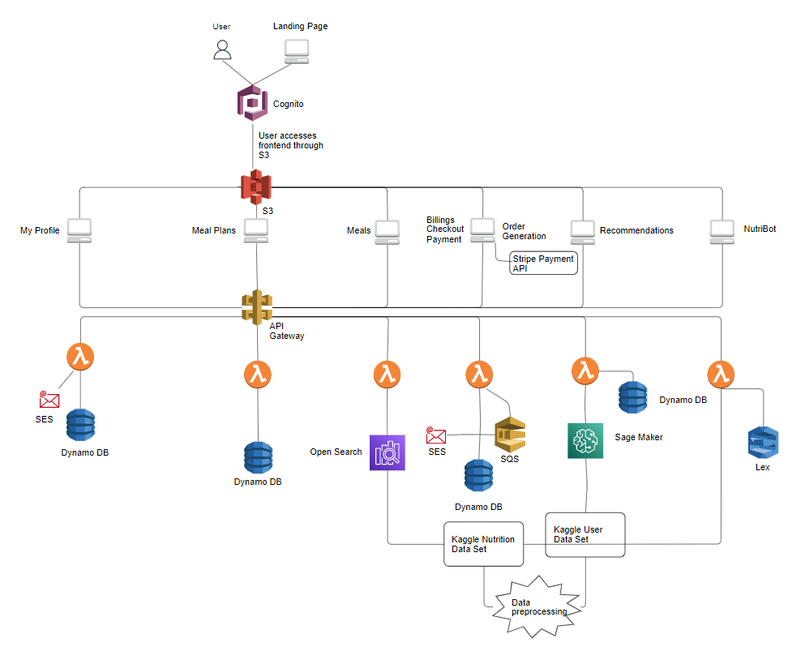
Architecture

Slide 5



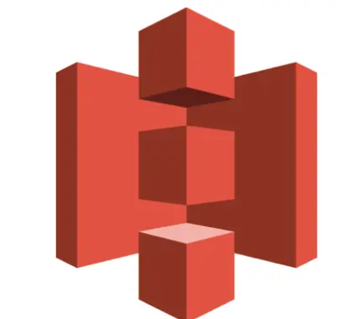


AWS Services Used in Be-Fit
COGNITO API GATEWAY LAMBDA
S3 OPEN SEARCH SQS

Slide 6

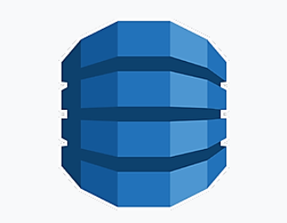


AWS Services Used in Be-Fit
SES DYNAMODB
SAGEMAKER LEX

Slide 7
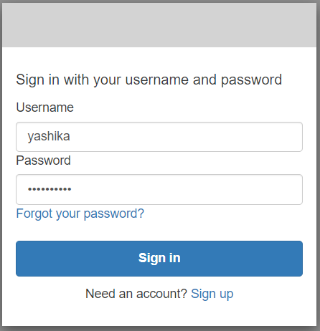
User Sign Up/Sign In
Be-Fit Uses Cognito for User authentication and User Management.
For New Users, In Sign up Process user is required to provide Username, email Id and password. User is also required to verify their email.
For existing users, In Sign in Process, user enters Username and password.

Slide 8
Dashboard
After authentication, user lands on the Dashboard. On the Dashboard User can view Tabs like Home, My Profile, Meal Plans, Meal Recommendations.
User can easily navigate to different pages from the Dashboard.

Slide 9
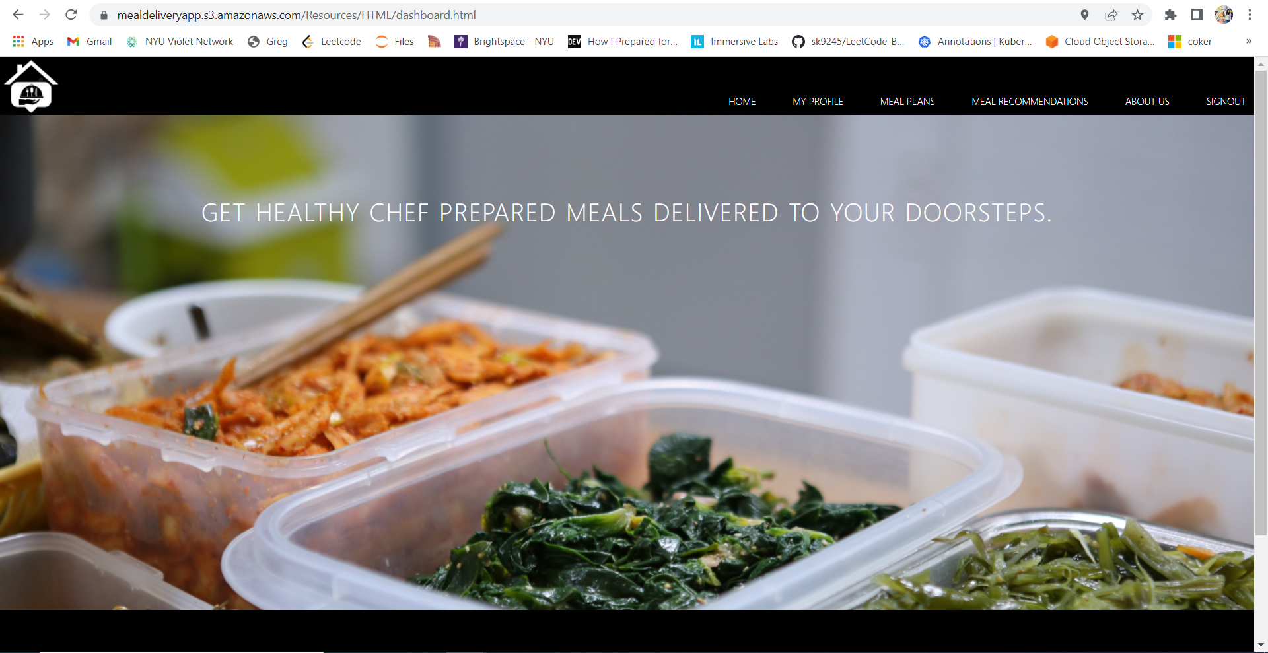

Slide 10
My Profile
In My Profile Screen, User will set/view their Information like:
Personal Information
Address
Meal Preferences
Health condition
Allergies
Dietary restrictions
Based on the information provided System will calculate BMI and Suggested Calories Consumption.

Slide 11
My Profile
This information will help Be-Fit App to suggest Meals based on their age, gender,height, weight, activity level and calories they should consume, along with their preferences like Low Carb, High Protein diets, Gluten free, Dairy free etc.
Once User clicks on Update, this information will be stored in DynamoDB.

Slide 12
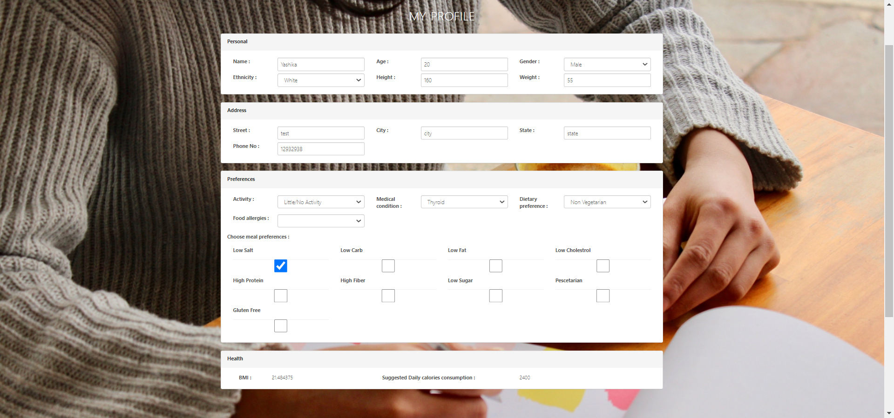

Slide 13
Meal Recommendations
In Meal Recommendation screen, Be-Fit suggests users Meals based on their Personal information like height, weight, gender, activity level, calories to be consumed in day, dietary preferences, meal preferences, medical conditions. This information needs to be set by user in the My Profile screen. This helps us in giving a more Personalised and clever Meal recommendations.
We have used Sage Maker for the recommendations. To train our model we have used User Information Dataset from Kaggle and for Preferences, we have used Nutrition Dataset from Kaggle.

Slide 14
Meal Recommendations
Based on our recommendations, if user wants to purchase our meal, they can select the meal to purchase. Once selected they will be redirected to the Billing Page where they can make the purchase.

Slide 15
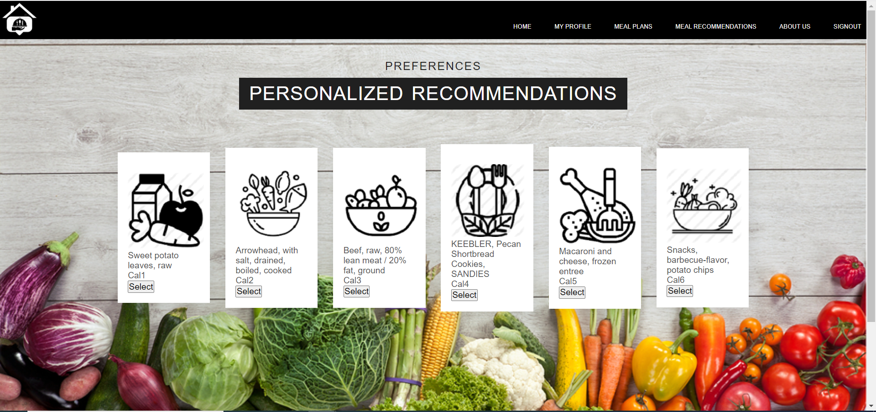

Slide 16
K means clustering
In order to find nutritional requirements of an individual a kmeans model was built on the calorie requirement dataset.
The number of clusters was taken as 30 and the number of instances to be compared was chosen as 1 giving high precision.
The output of the model on current users details are used to predict his calorie requirement.
These are then forwarded to the next stage.

Slide 17
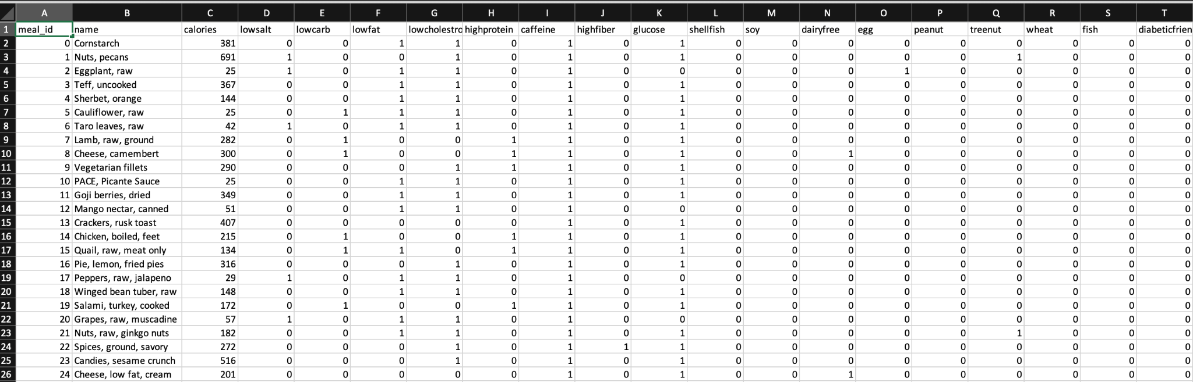
We take the users age, sex, weight,height, calorie intake from the dynamodb.
We invoke the sagemaker endpoint.
The output of the endpoint are stored into 2 csv files:
1.distance_to_cluster, closest_cluster,calorie intake
2.One hot encoding of the meals is based on the WHO/FDA recommended standards. The output of which are categories of meal plans.

Slide 18
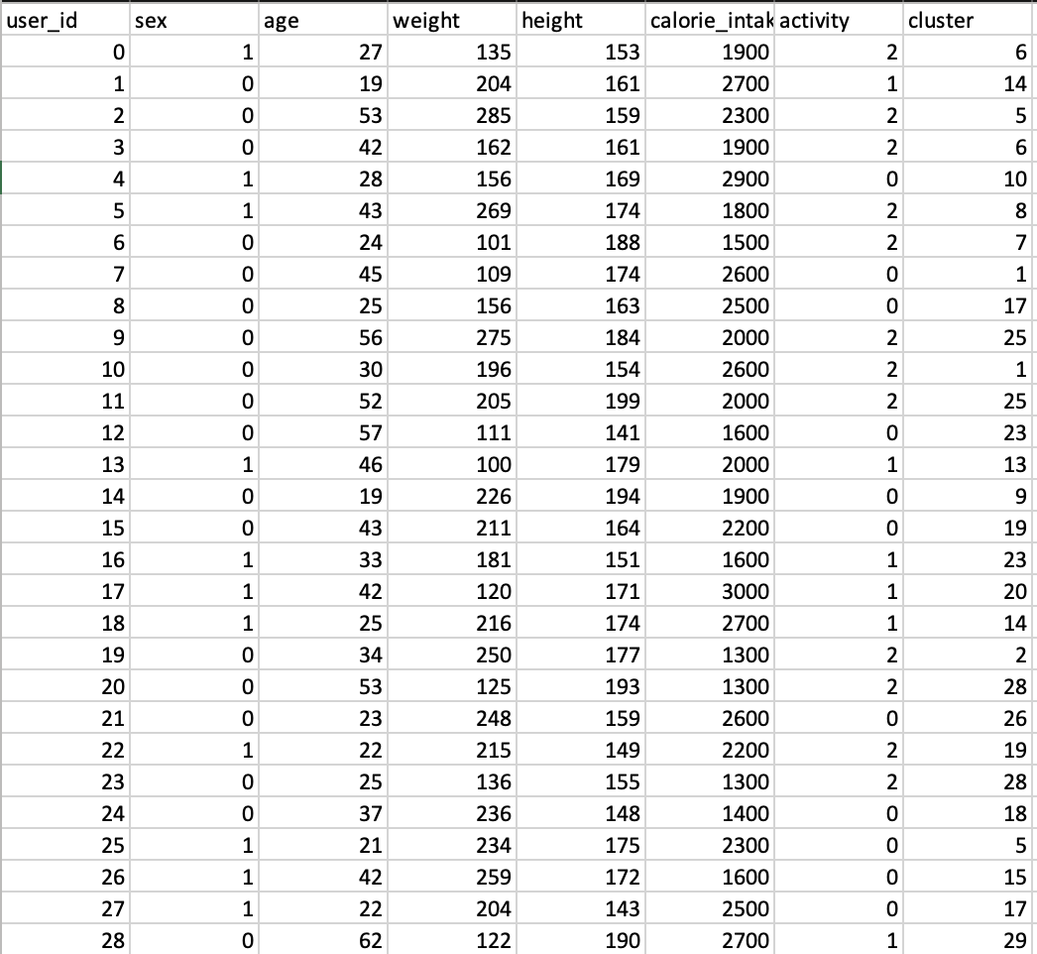
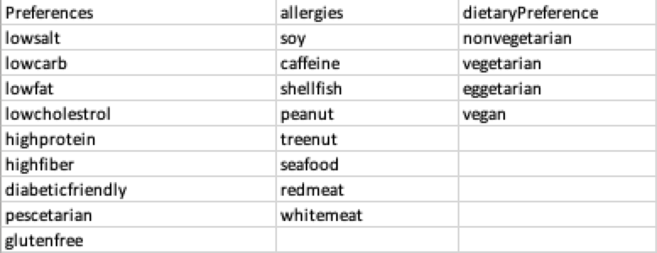
We take the calorie consumption from the cluster this user belongs to.
Since our application recommends the meals that the user can eat in day. We assume the user eats 3 meals in a day. The calories of each of the meal recommended will be below the daily calorie intake divided by 3.
Then,we filter out the meals based on his preferences, allergies, dietary preference as listed.
These meals are recommended to the user

Slide 19
NLP preprocessing and Classification
We took a Nutrition dataset from Kaggle.
We utilized NLP preprocessing to convert the name feature into 14 useful features.
The features were all one hot encoded for easy deployment.
After taking the input from the user we run a basic lambda classification on our dataset.
On the basis of the classification output we recommend the user what to eat.

Slide 20
Meal Plans
Be-Fit offers Meal Plans subscription service.
User can choose the meal plan that they want to subscribe to from my carefully curated List of Meal Plans. We have a variety of Plans like :
Low Carb Meals
Gluten free Meals
Diabetic Friendly Meals
Dairy Free Meals
Low Salt Meals
Vegan Meals
Low Cholesterol
High Protein
Fiber rich
Low Fat
Ovo Vegetarian Meal
Ovo lac Vegan
Pescetarian

Slide 21
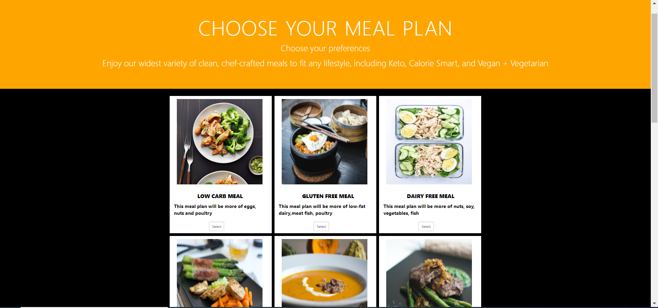

Slide 22
Meals
Once user clicks on any Meal name they can view the kind of meals they can expect delivered to their doorsteps if they subscribe to the selected Meal Plan. This helps give User a good Idea of our delicious meals specially designed by us.
We have used Opensearch in searching Meals for Meals Plans. These meals have been carefully re processed and stored in opensearch based on their respective categories.

Slide 23
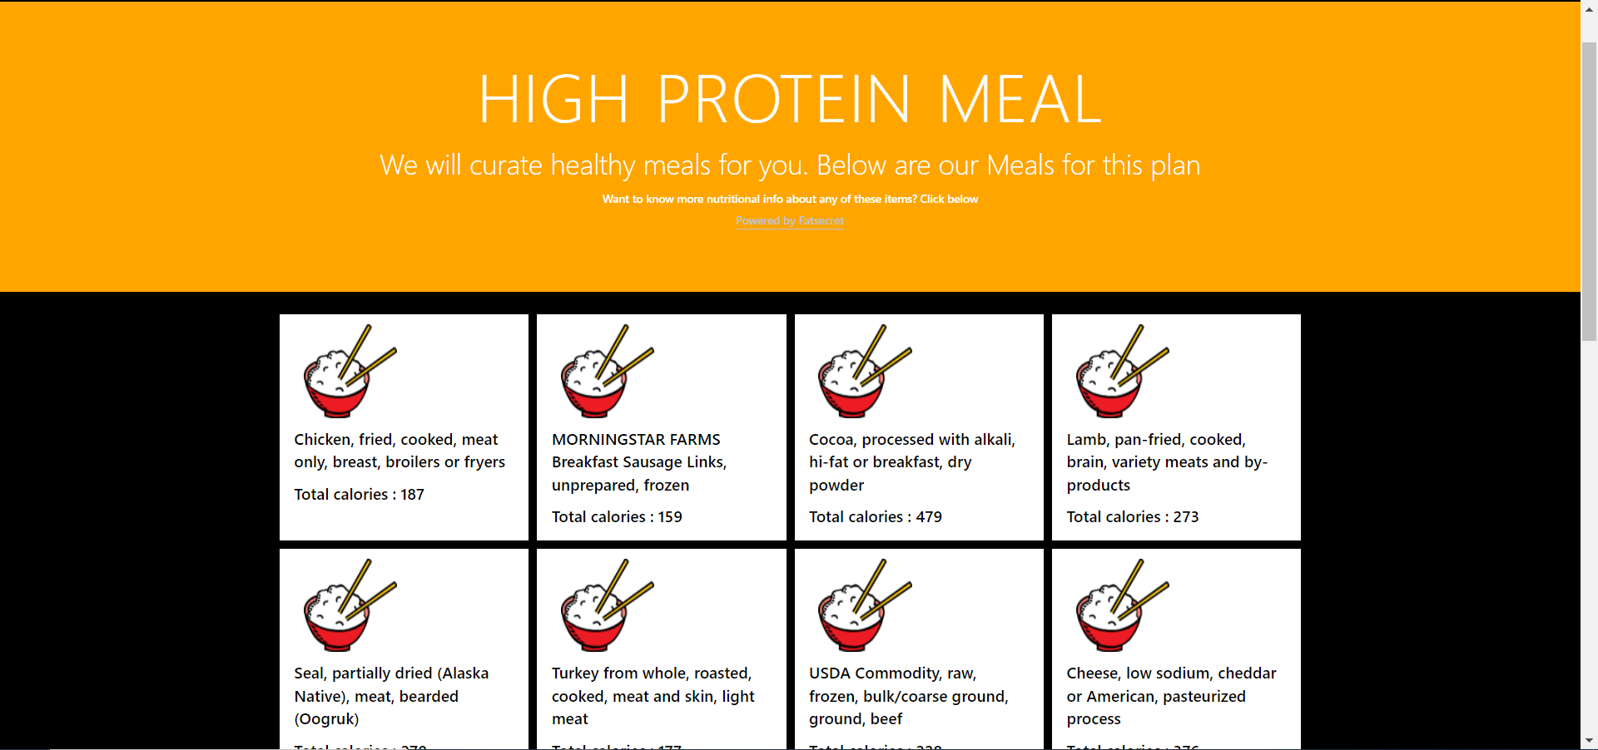

Slide 24
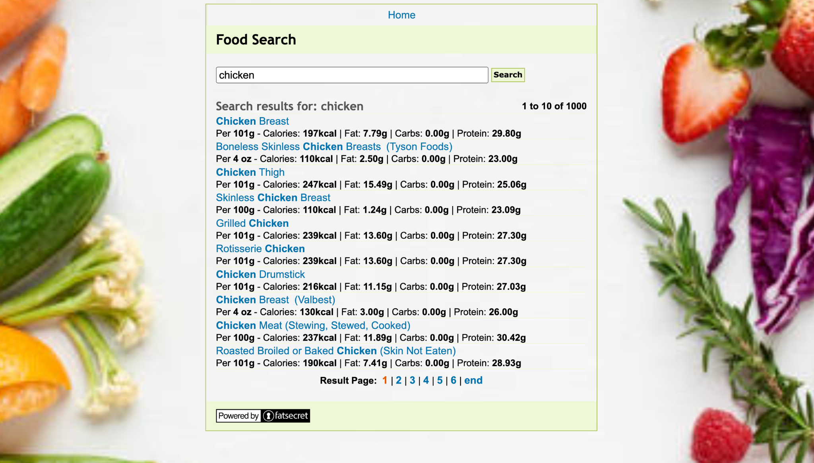
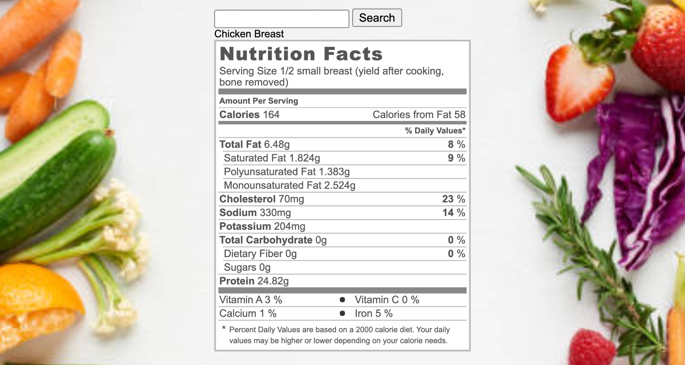

Slide 25
Meal Frequency and Pricing
Once User selected a particular meal plan to subscribe. They will land on Choose Meal plan page. They can select the frequency of the subscription. Like 4 meals/week, 6 meals/week, 8 meals/week etc. They also be able to see Prices of the subscriptions.

Slide 26
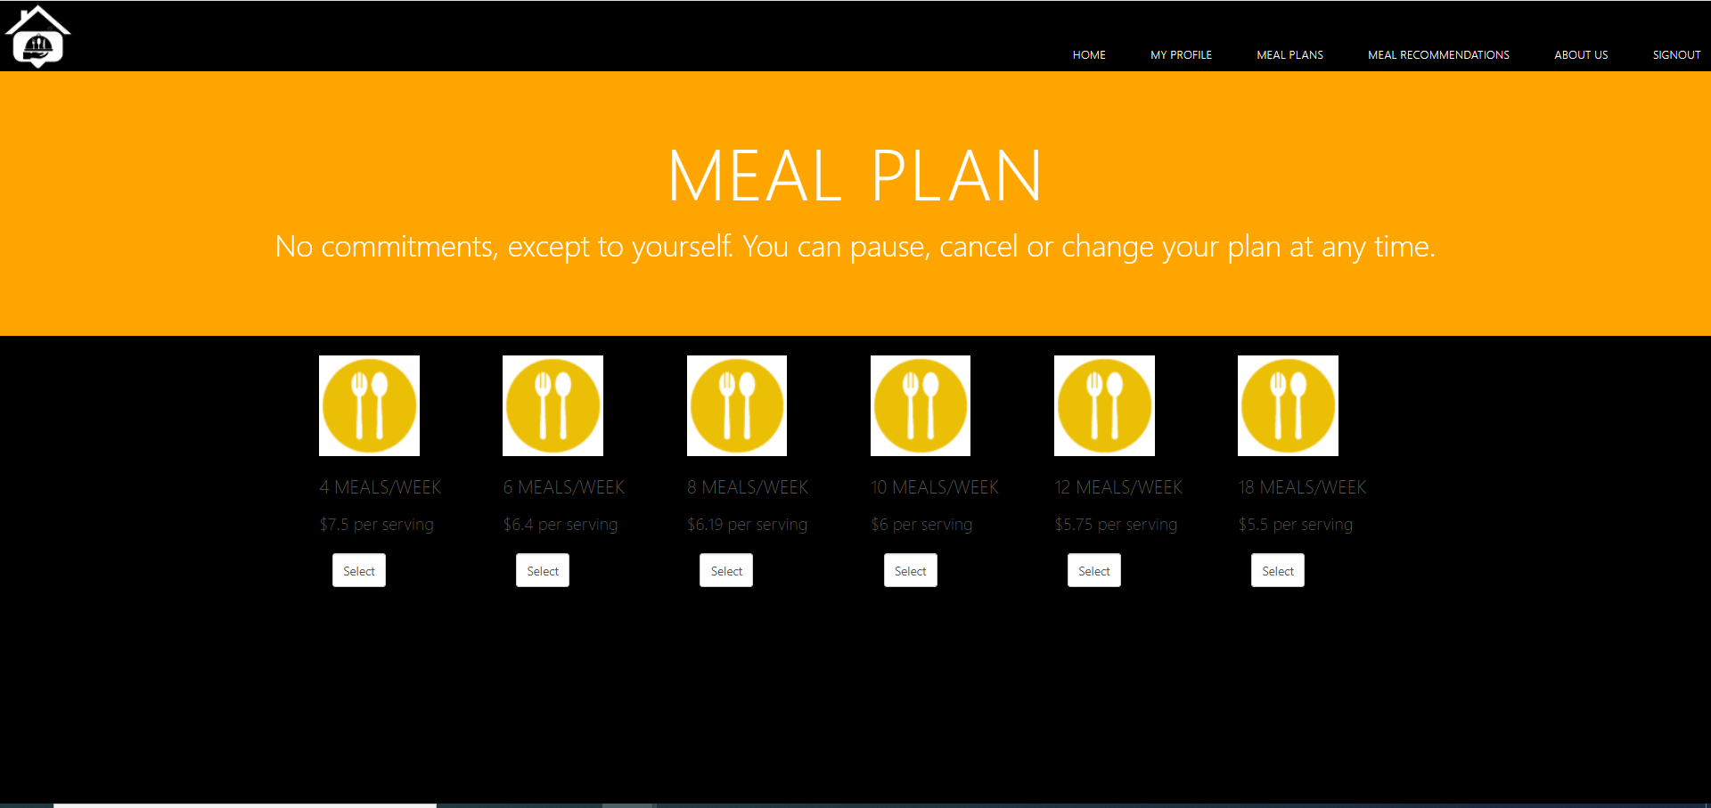

Slide 27
Checkout and Billing
On selecting a Meal Plan and its frequency, User will Land on the Checkout Page where they can carefully review their subscription details.
On confirming, User will enter Payment details and submit Order.
We have used DynamoDB to store Order Details, SQS with SES to send Order confirmation email to our User.

Slide 28
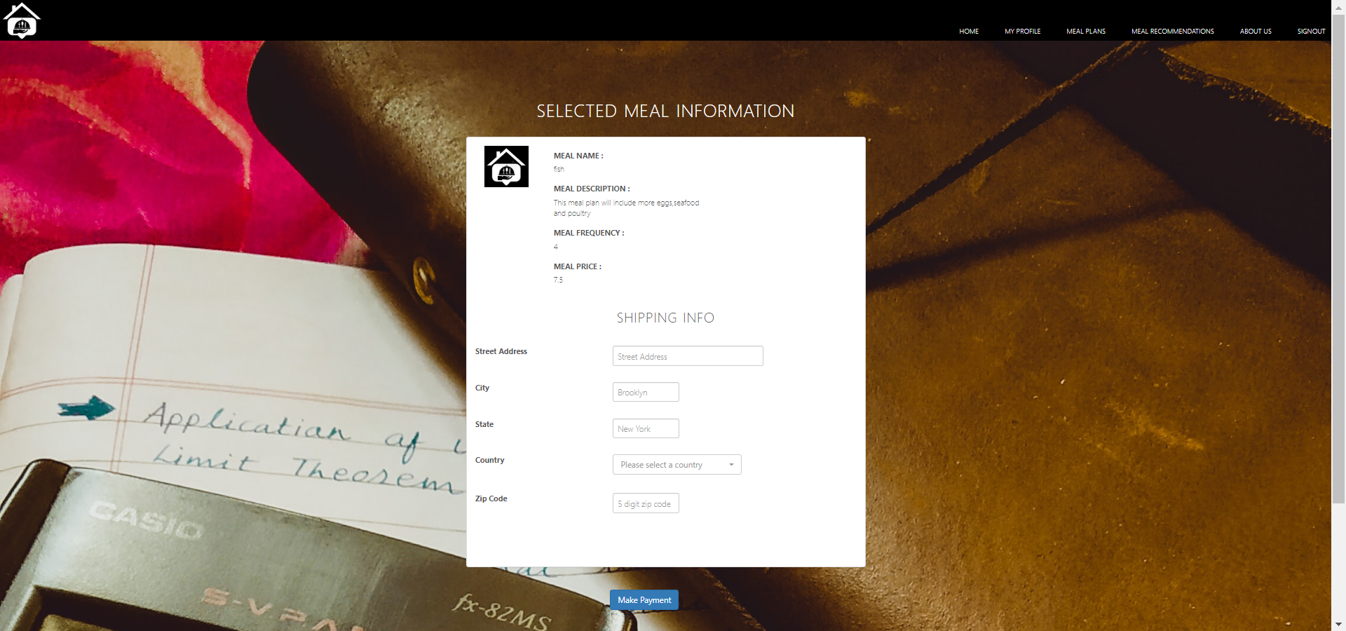

Slide 29
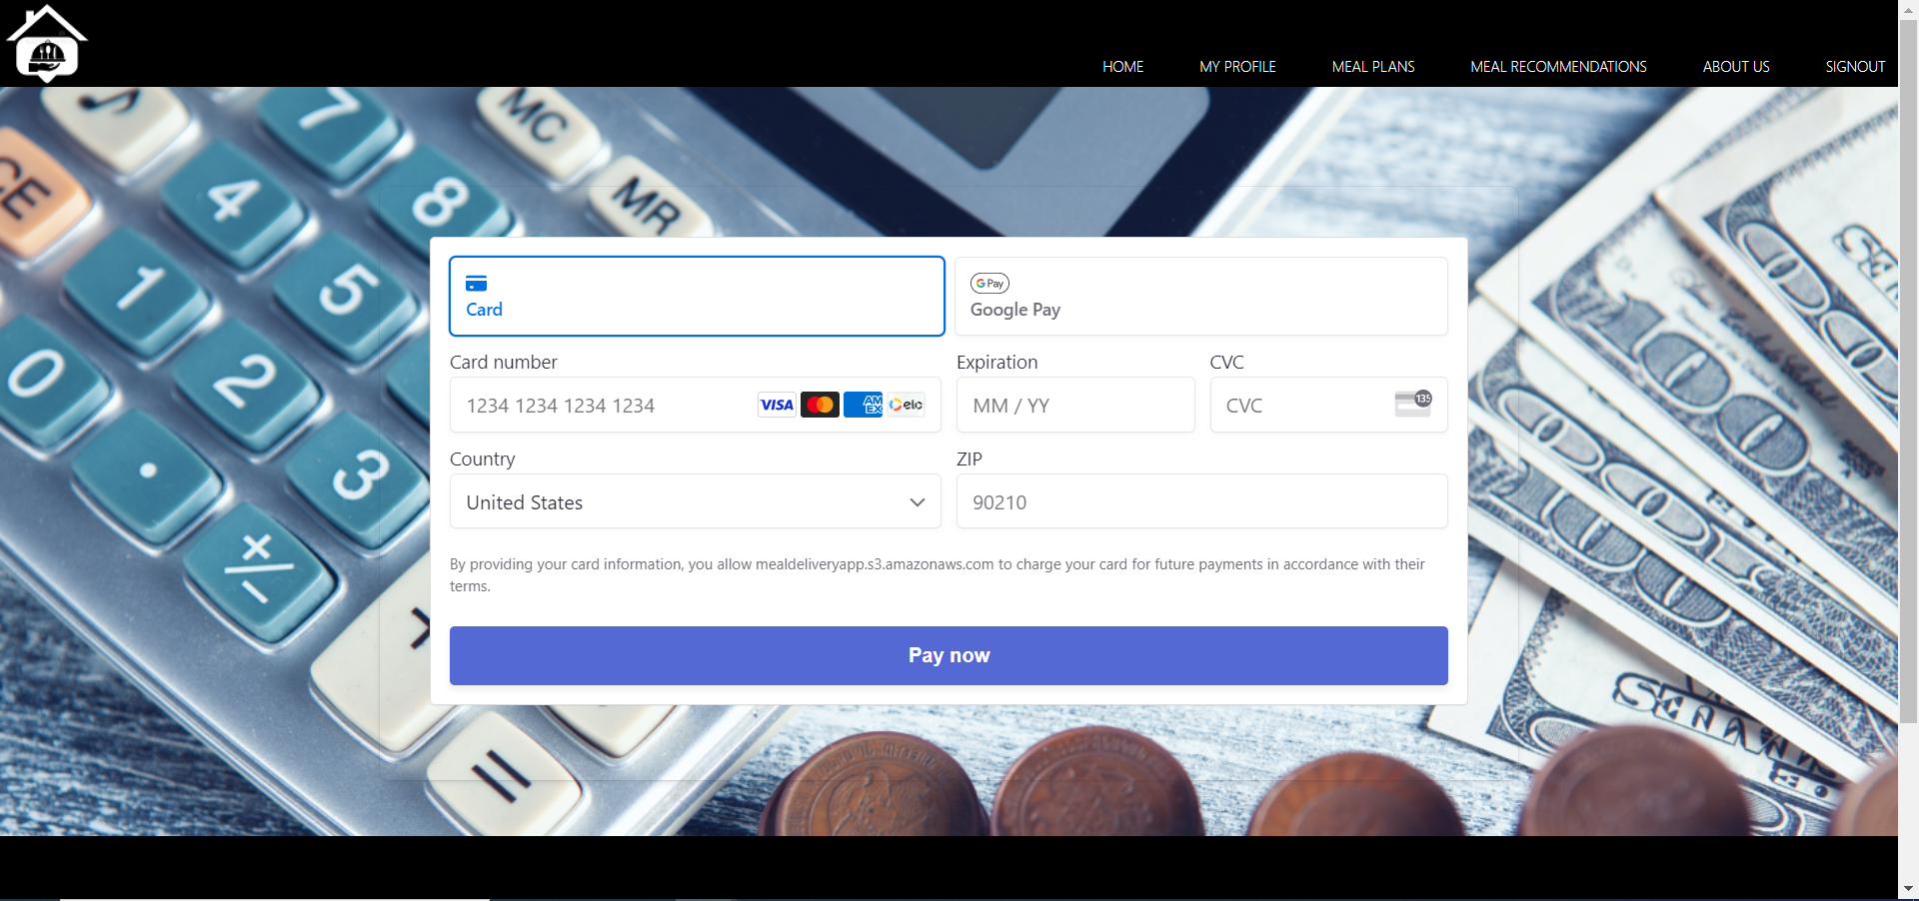

Slide 30
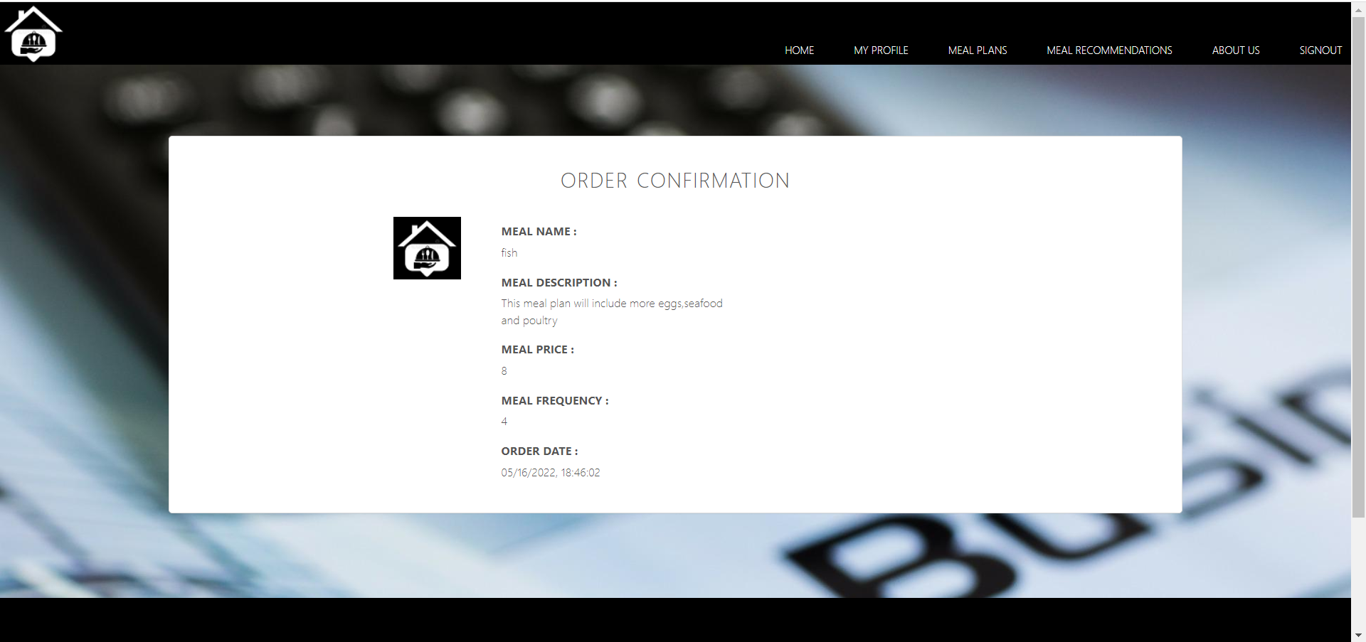

Slide 31
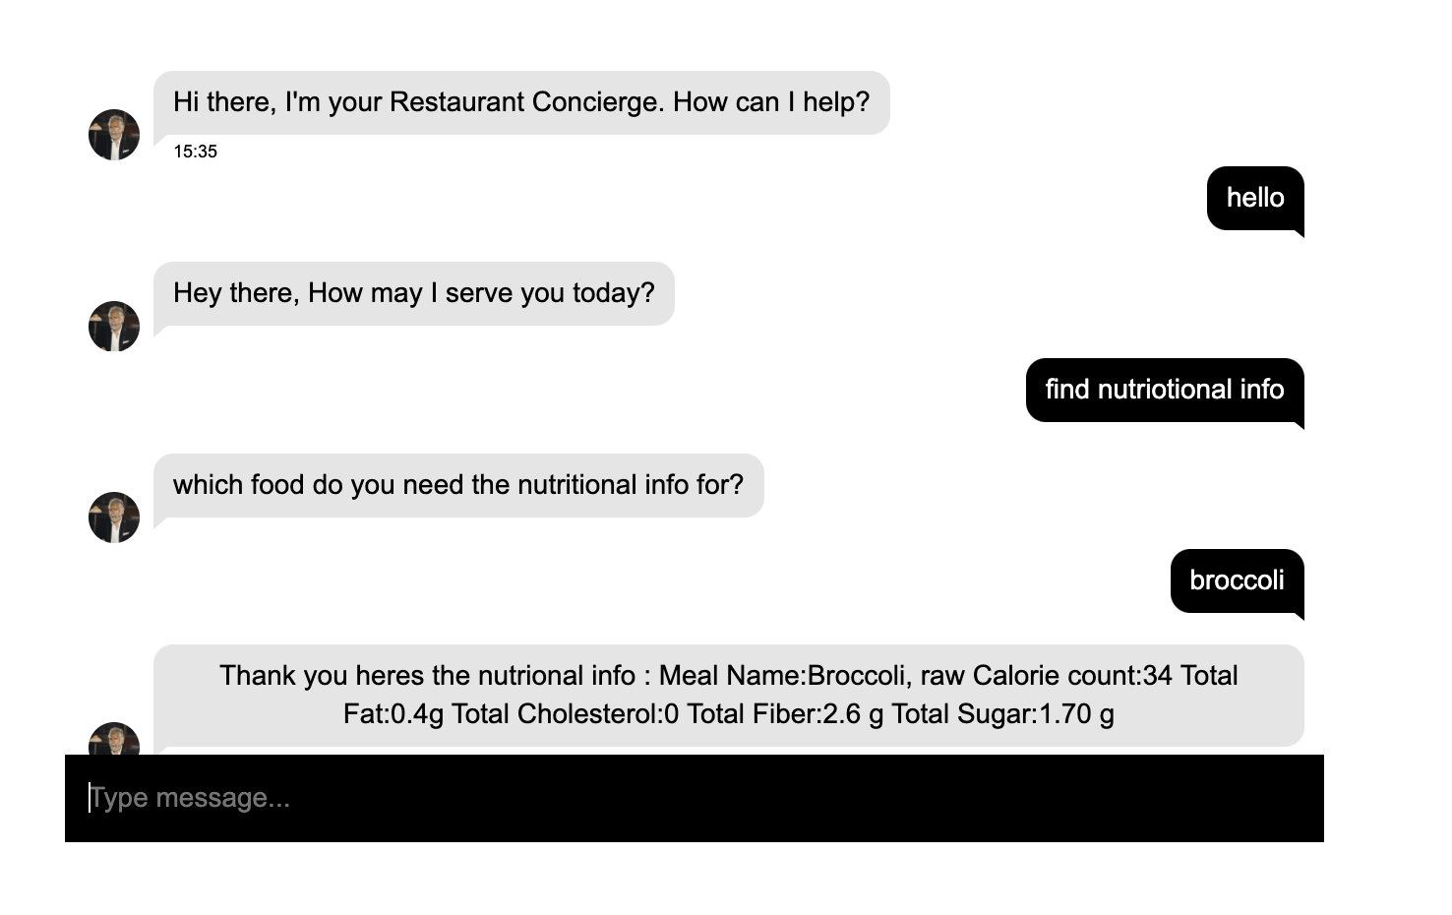

Slide 32
Thank you

